Slide 1
Experiment 9 - Air cushion rail
by Robin Hoffmann and Arik Bürkle

Slide 2
Table of content
Uncertainties
Stokes Frictions
Uniformly accelerated movement
Mean velocity Two-Gates-Method
Current velocity One-Gate-Method
Current velocity Two-Gates-Method
Gravity acceleration
Collisions
Elastic collisions
Inelastic collisions

Slide 3
Introduction
What is the experiment?
Why do we do it?
What conclusions do we get from the the experiment?

Slide 4
Theory of uncertainties
Every observable has a corresponding error. Those errors propagate through out all calculations.
For this experiment the errors are calculated with the Gaus-Error-Propagation via a Python-script.
Linear fits also have a corresponding error which is connected to how good the points fit on the graph.

Slide 5
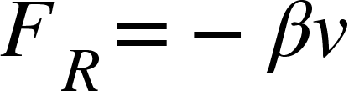
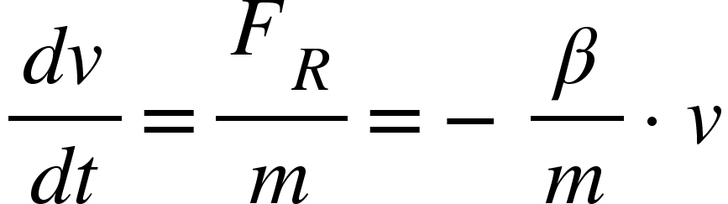
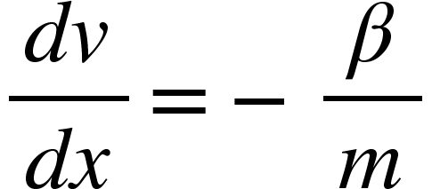
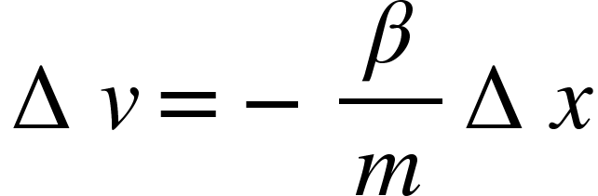
Stokes friction
Is a force acting on any moving object opposite to the direction it is moving:
This can be expressed as an differential funktion:
We can rewrite to
This means that there is a change of the velocities do to friction, which depends proportional to the distance traveled:
This has to be used as a correction for the calculated velocities and the acceleration that depends on it.

Slide 6
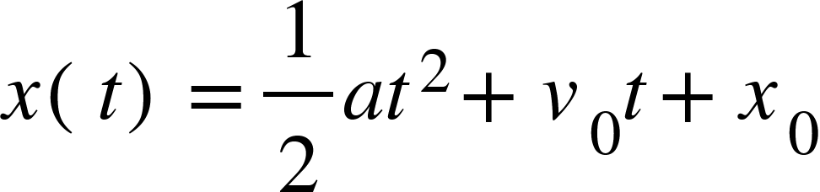
Uniformly accelerated movement
What is uniformly accelerated movement
With two different ways to calculate the acceleration:
1. By measuring the mean velocity over a given distance
2. By measuring the speed at two different points

Slide 7
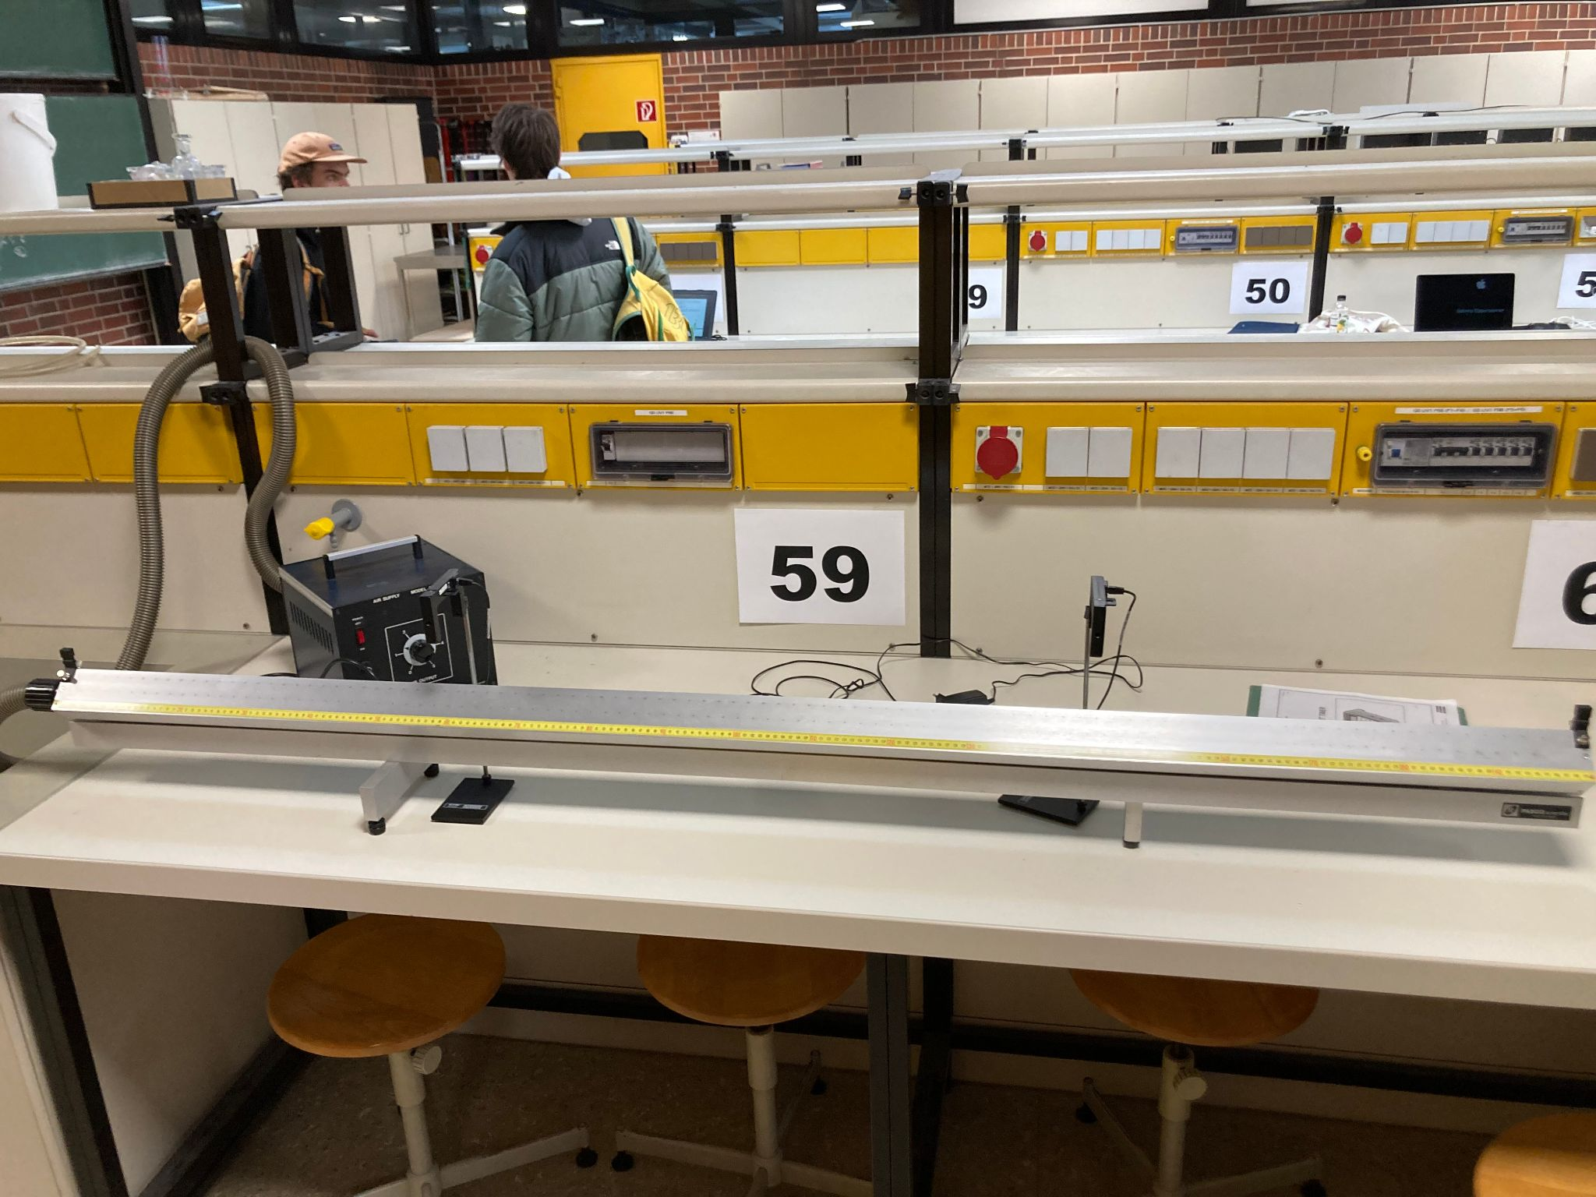

Slide 8
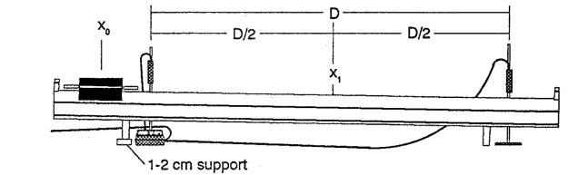
Mean Velocity
To calculate the mean velocity we placed to light gates at a distance D/2 from x and measure the time it takes the cart to travel the distance D.
The distance D is then shortened by 20cm and we redo the measuring.

Slide 9
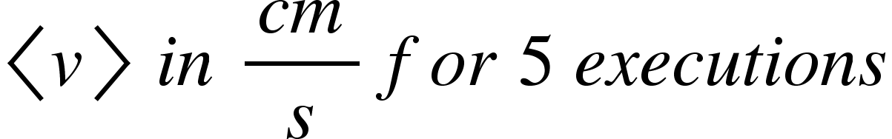

Result data for mean velocity with Two-Gate-Methode
140,0(5) | 49,88(8)
120,0(5) | 51,17(10)
100,0(5) | 52,01(12)
80,0(5) | 52,6(2)
60,0(5) | 53,0(2)
40,0(5) | 52,9(3)
20,0(5) | 52,2(6)

Slide 10
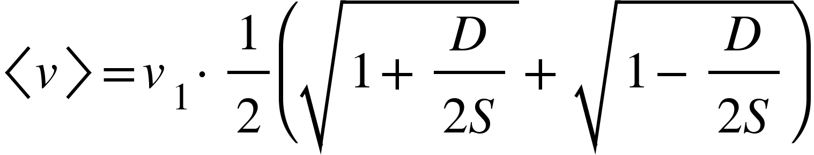
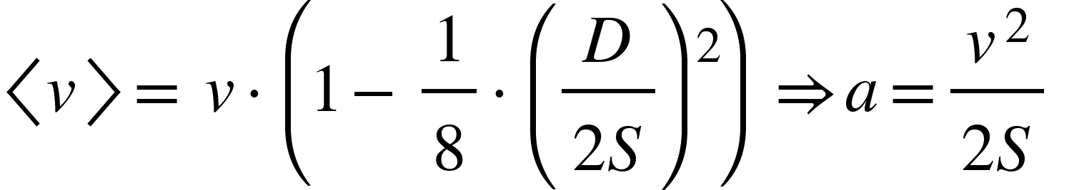
Mean velocity
The mean velocity is connected to the current velocity with this Equation:
Taylor expansion gives a quadratic equation for the mean velocity:

Slide 11
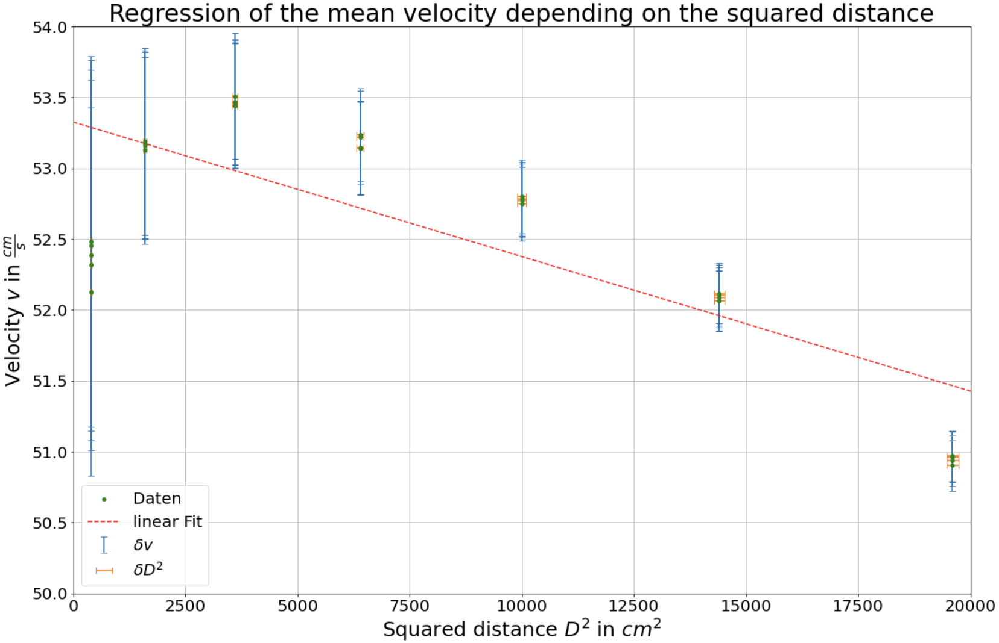
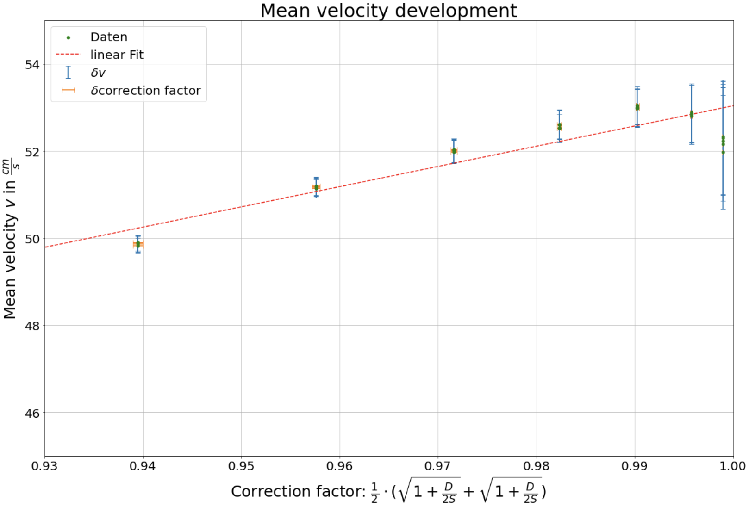
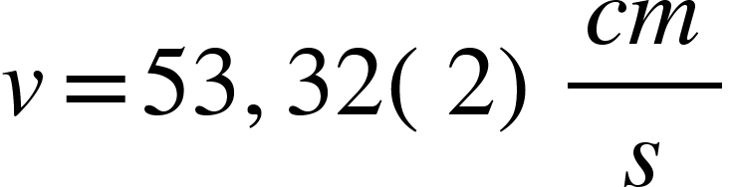
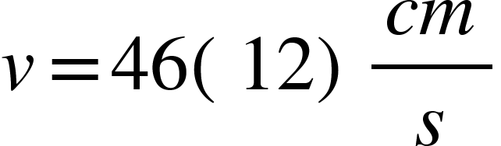
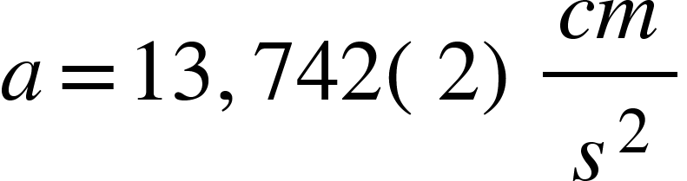
Data fits
→ y-axis:
→ acceleration:
→ slope:

Slide 12
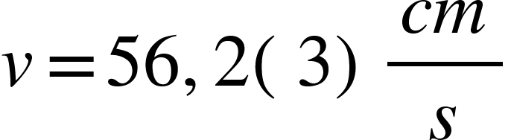
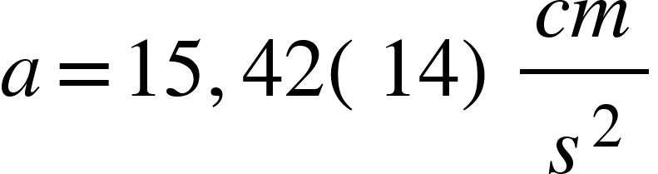
Measuring the current velocity
The light gates can also measure the current velocity
we can use this to verify our measure speed with the One-Gate-Method
From this we get a velocity of
This results in an acceleration of

Slide 13
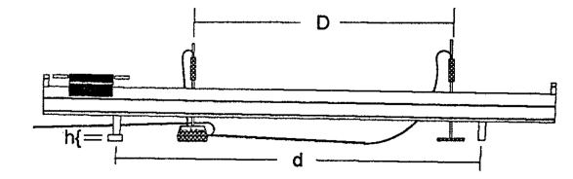
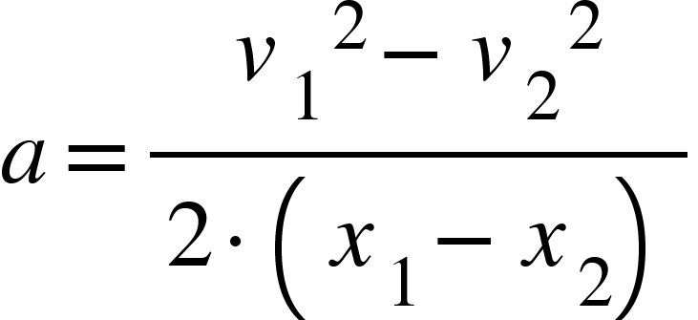
Two velocitys
Measuring the current velocities at two different points on the rail can also be used to calculated the acceleration.

Slide 14
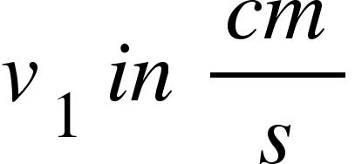
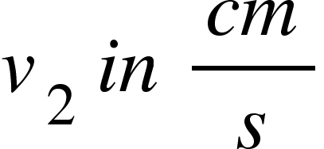

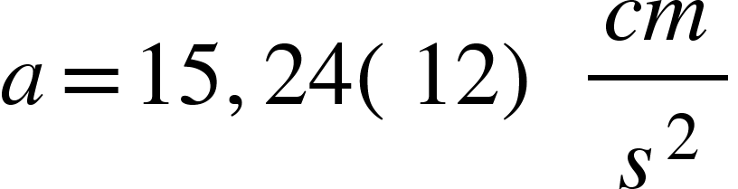
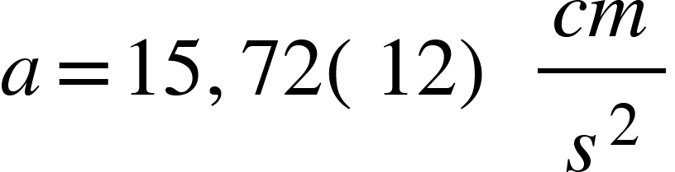
Result data for direct velocity with One-Gate-Methode
80,0(5) | 39,0(3) | 63,2(3)
80,0(5) | 39,0(3) | 62,8(3)
80,0(5) | 38,7(3) | 62,8(3)
80,0(5) | 39,0(3) | 62,8(3)
80,0(5) | 38,9(3) | 62,8(3)
80,0(5) | 38,9(3) | 62,8(3)
→ Mean acceleration: with friction

Slide 15
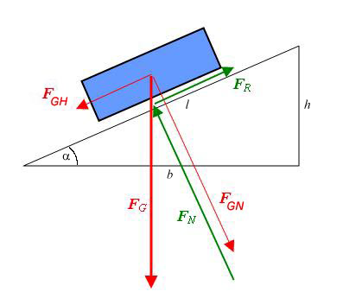
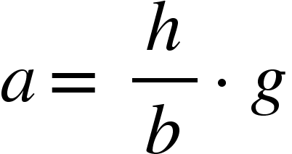
Acceleration to gravity
In this experiment there is an inclined path on which gravity acts. The acceleration is the parallel component from the gravity tied to the angel of the the path.
From the triangle congruence we get:
h: height of the cube
b: length between the mounts
g: gravitational acceleration

Slide 16
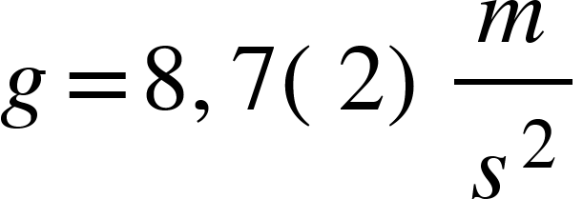
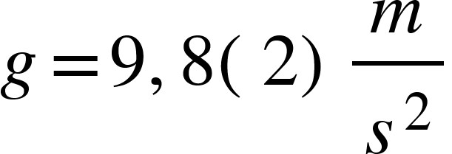
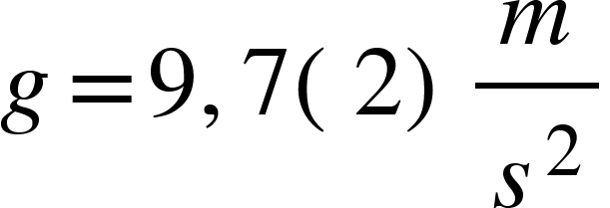
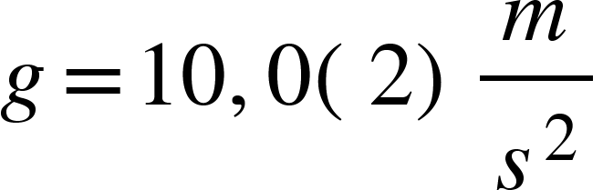
Calculating the gravity acceleration
Gravitational acceleration from mean velocity :
Gravitational acceleration from direct velocity with One-Gate-Methode:
Gravitational acceleration from Two-Gate-Methode:
Correction do to Stokes friction:
Gravitational acceleration from mean velocity:
Gravitational acceleration from direct velocity with One-Gate-Methode:
Gravitational acceleration from Two-Gate-Methode:

Slide 17
Momentum and collisions
There are two different types of collisions:
Elastic: The two objects bounce of each other and are not deformed. Afterwards the two objects travel separated from each other.
Inelastic: The two objects deform in a way that connects them. Afterwards the two objects travel together as one.

Slide 18
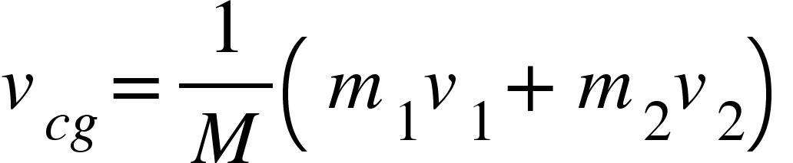
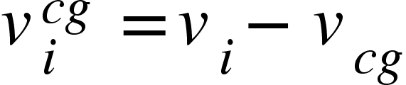
Center of gravity system
The basis of a collisions is the theory of center of gravity systemes
It describes an inertia system tied to the center of gravity of our mass configuration.
The velocity of the center of gravity is given by:
Using Gaus-transformations we move the velocities into the center of gravity system:

Slide 19




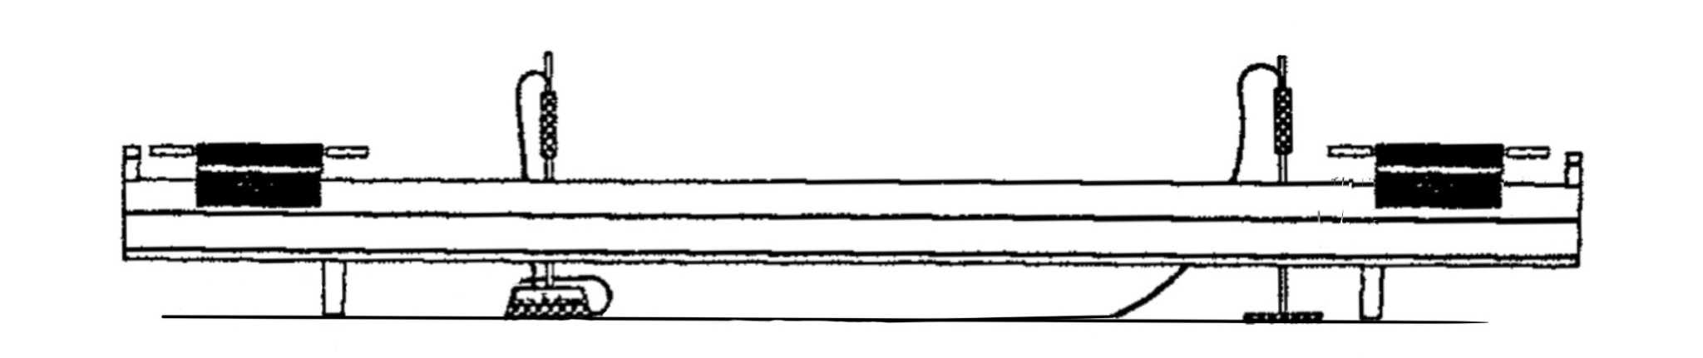
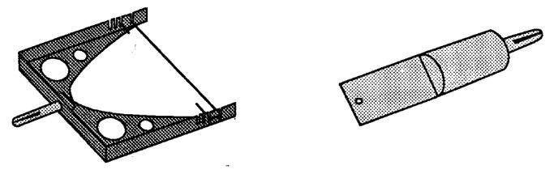
Elastic collision
Light gate 1
Light gate 2

Slide 20
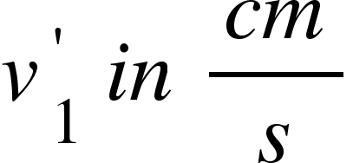
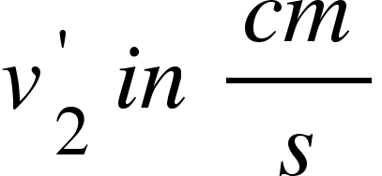
Result data for elastic collision
29,4(3) | 25,9(3) | 27,4(3) | 27,3(3) | 0(1)
29,9(3) | 31,4(3) | 33,2(3) | 27,6(3) | 0(1)
21,5(3) | 23,9(3) | 24,3(3) | 19,0(3) | 0(1)
25,8(3) | 29,1(3) | 30,1(3) | 23,2(3) | 0(1)
34,4(3) | 28,9(3) | 30,3(3) | 31,9(3) | 0(1)
25,3(3) | 9,5(3) | 27,2(3) | 40,0(3) | 200(1)
18,2(3) | 10,8(3) | 24,7(3) | 29,8(3) | 200(1)
15,8(3) | 20,7(3) | 39,2(3) | 30,6(3) | 200(1)
11,8(3) | 14,2(3) | 26,5(3) | 21,6(3) | 200(1)
17,8(3) | 21,8(3) | 42,0(3) | 34,1(3) | 200(1)

Slide 21
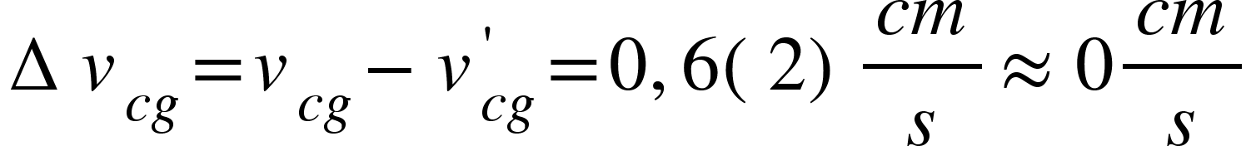
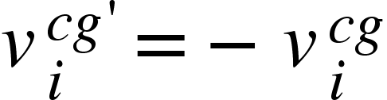
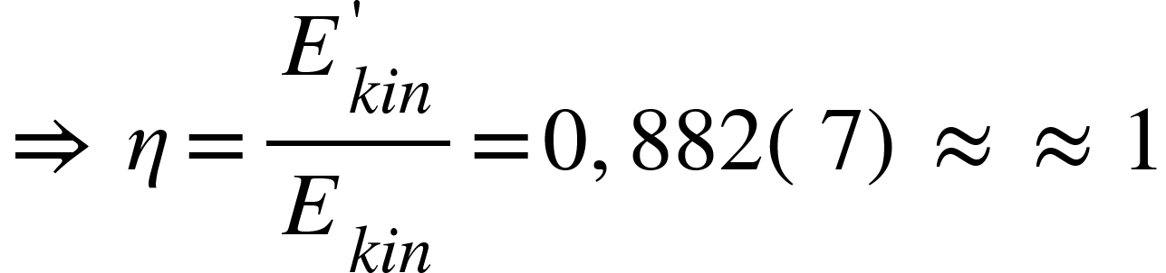
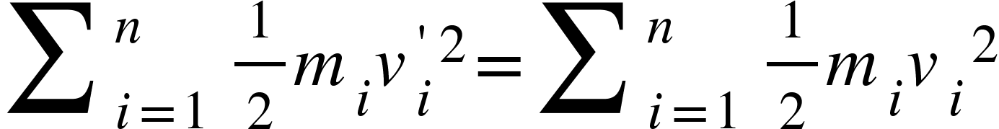
Elastic collisions
In an elastic collision the momentum should preserved this means that: ✅
Energie is also preserved, the kinetic energy should be the same before and after the collision: ✅

Slide 22
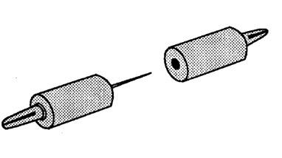
Inelastic collision
Light gate 1
Light gate 2

Slide 23
Result data for inelastic collision
52,9(3) | 6,8(3) | 66,6(3) | - | 0(1)
32,5(3) | 11,4(3) | 59,1(3) | - | 0(1)
15,3(3) | 16,1(3) | 50,2(3) | - | 0(1)
13,6(3) | 18,4(3) | 53,4(3) | - | 0(1)
19,7(3) | 12,8(3) | 46,2(3) | - | 0(1)
34,0(3) | 21,9(3) | 53,7(3) | - | 200(1)
31,5(3) | 23,3(3) | 54,6(3) | - | 200(1)
35,9(3) | 13,6(3) | 40,0(3) | - | 200(1)
36,9(3) | 12,7(3) | 31,1(3) | - | 200(1)
33,2(3) | 16,1(3) | 42,3(3) | - | 200(1)

Slide 24
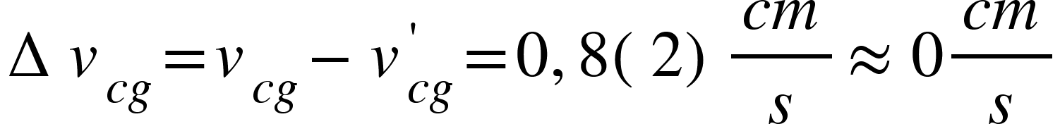
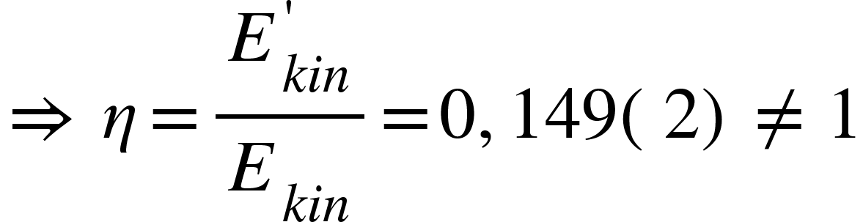
Inelastic collisions
In an inelastic collision the momentum should still be preserved: ✅
The kinetic energy is not preserved because parts of the cart are deforming: ❌

Slide 25
Any Questions?

Slide 26
Sources
https://de.wikipedia.org/wiki/Schiefe_Ebene#/media/Datei:Schiefe_ebene_4.png
https://lms.uibk.ac.at/auth/Document/1301386

Slide 27
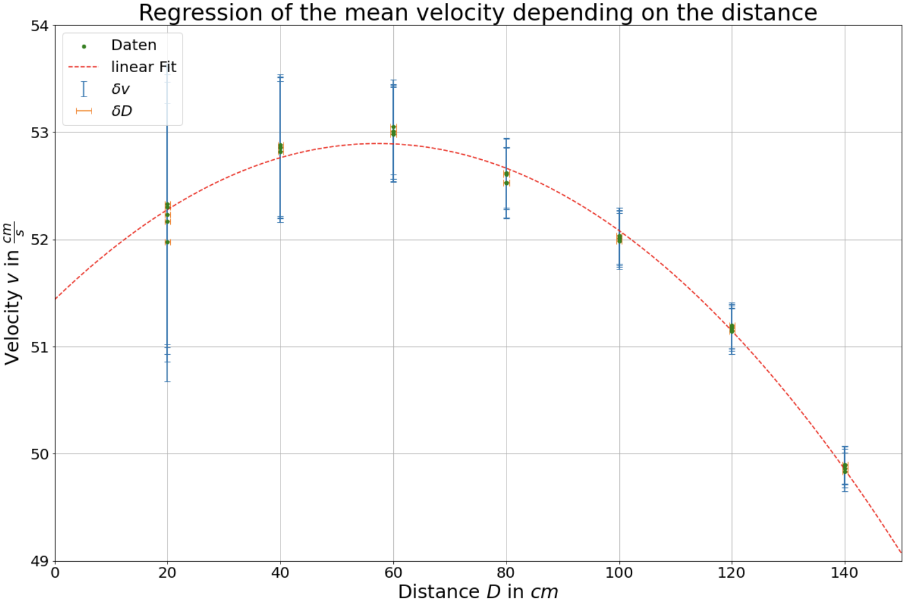
Extras

